Slide 1


Slide 2
Cloud @ eBay From ground level to clouds
JC Martin Cloud Architect, eBay Marketplace

Slide 3
What is eBay.com
Data Analytics
Search
Front End
2
200
200M live listings
2B page views/day
6,000
9
6,000 application servers
250
9 Pb of data
94
250M queries/day
94M active users
23
$62
75
23M SLOC
$62B 2010 gross merchandise volume
75B database calls/day

Slide 4
What is eBay.com
Data Analytics
Search
Front End
Beta
PCI
Compliant
Production
PCI
Compliant
Research
Skunkworks
QA

Slide 5

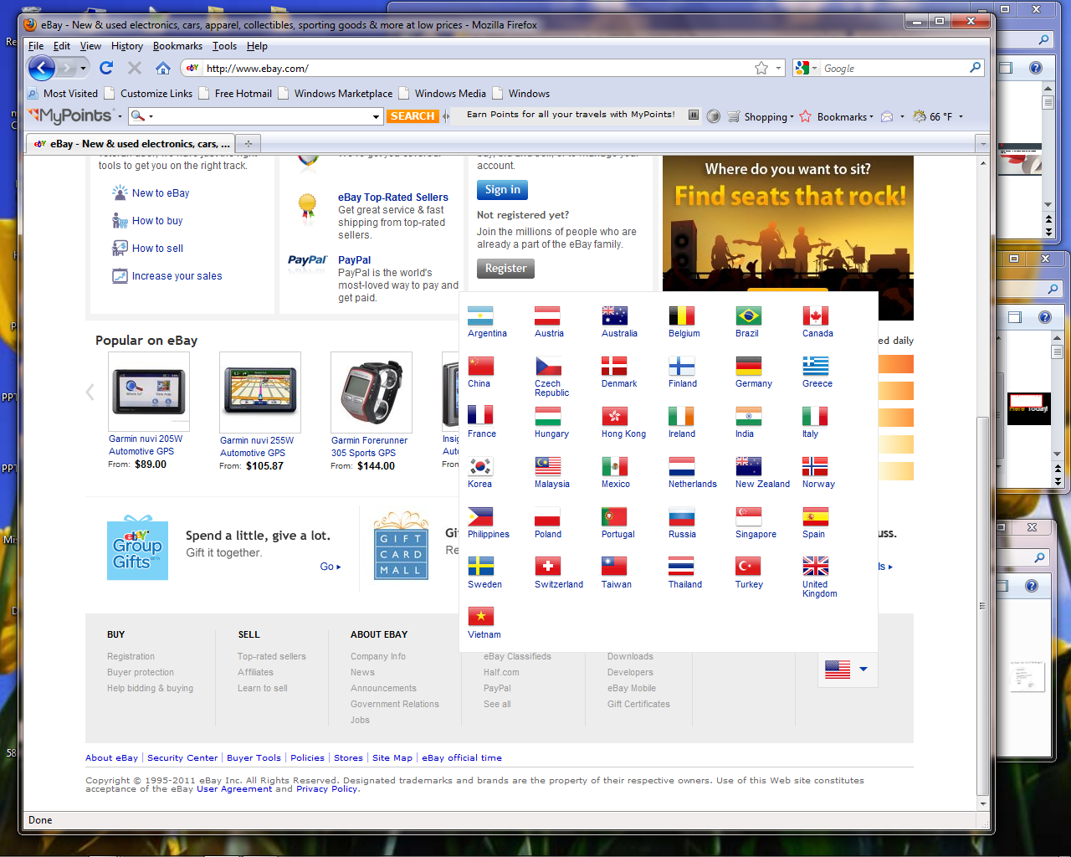











Slide 6
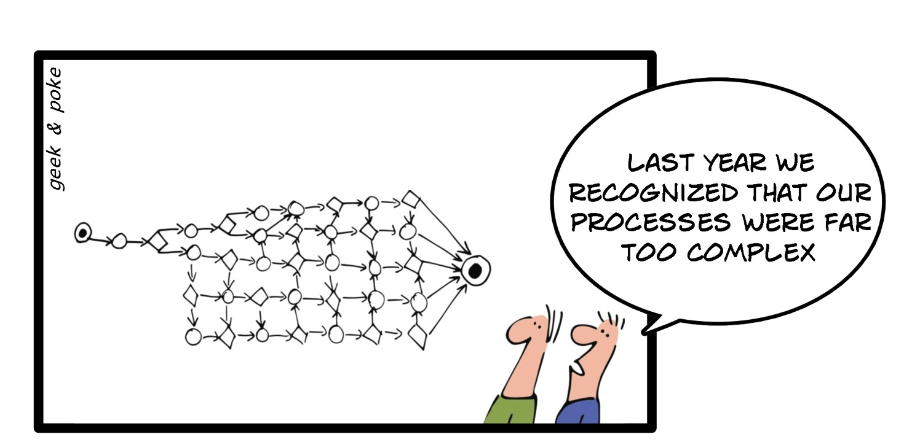
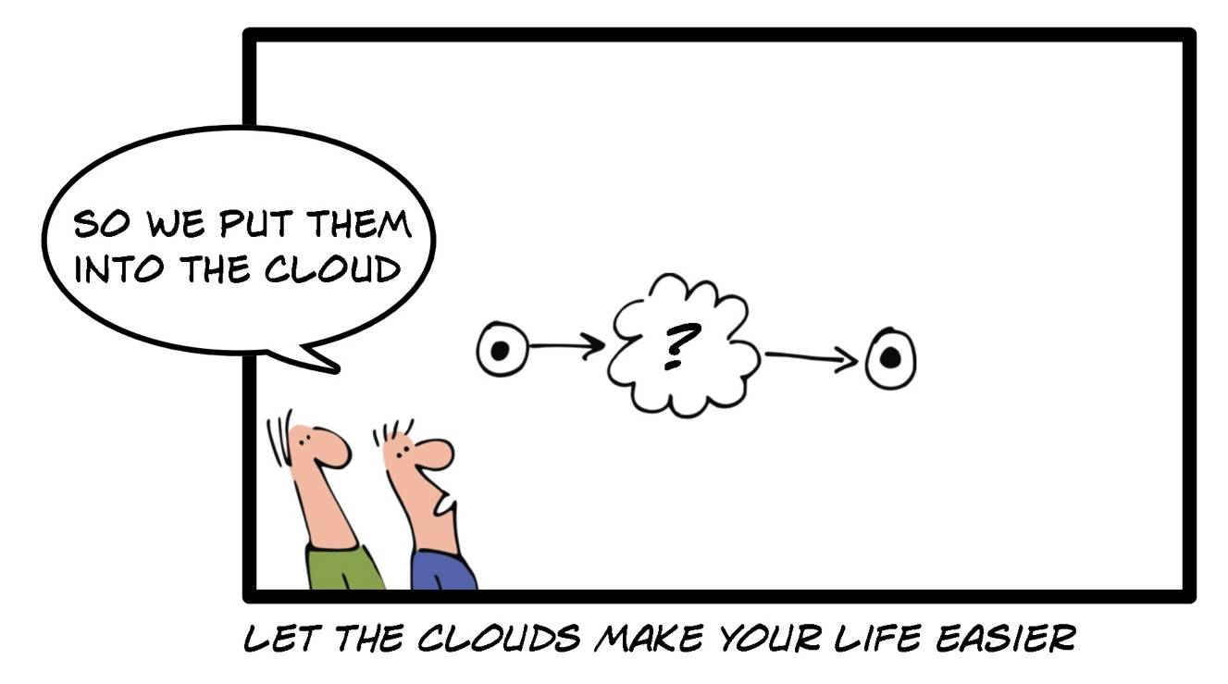

Slide 7
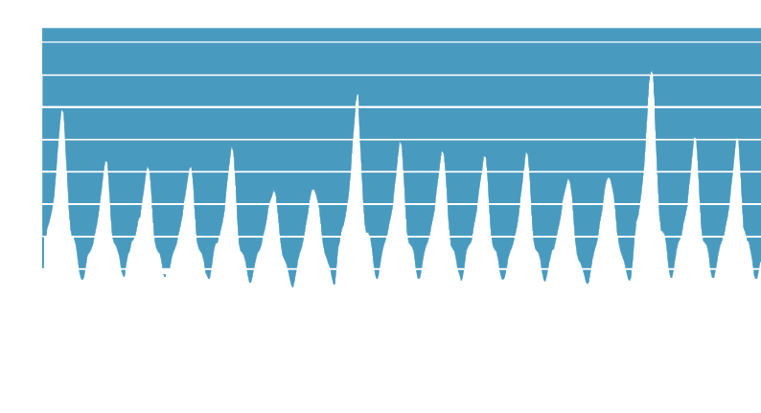
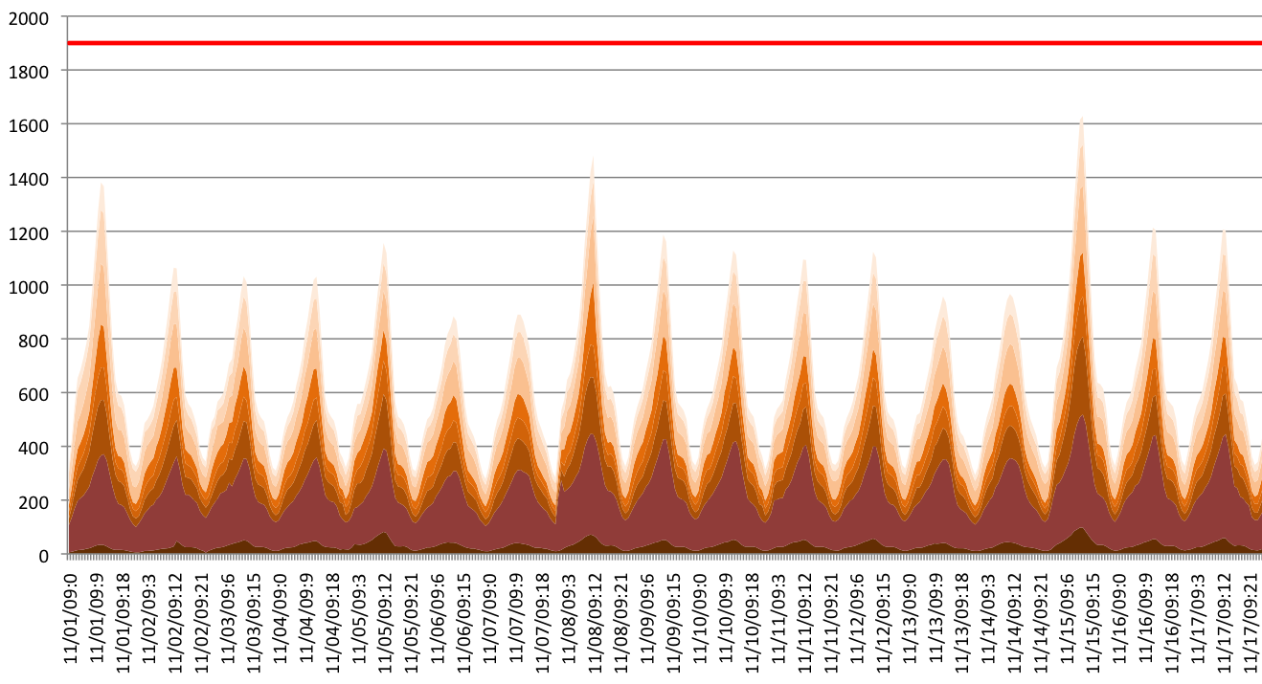
Burst to external
Cloud ?
DR
Number of servers required based on utilization for 8 pools

Slide 8
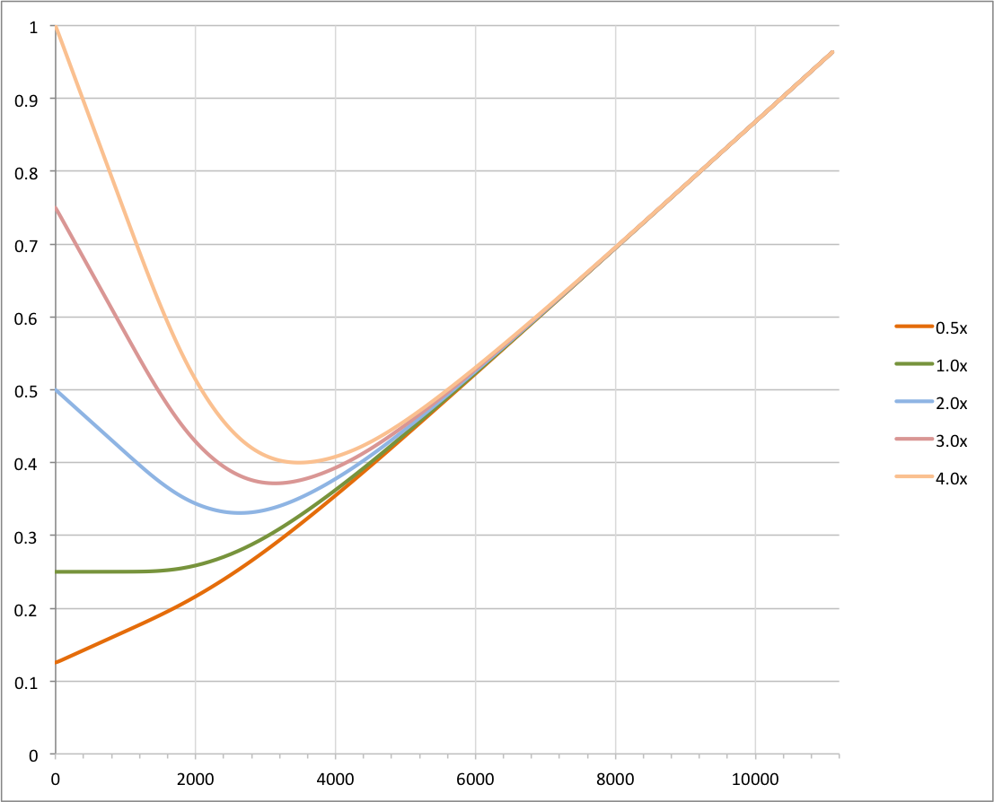
Even at 4x the internal cost, public cloud would save money
Cloud cost to
Internal cost
ratio
Cost ratio
Internal cost is dominant
External cost is dominant
Servers owned

Slide 9
?
Private
Public
Hybrid
Build
Buy
Build + OSS

Slide 10



Hybrid Cloud options
eBay DC
Public Cloud
eBay DC
Public Cloud
Ebay environment
Ebay environment
Ebay Infrastructure
Ebay Infrastructure
Virtual Data Center
Public Shared Cloud
Notes:
Virtual Data Center
External cloud looks like an extension of eBay DC
All traffic goes through VPN (or private peering)
Internal IP space is shared between two domains
eBay’s DNS zones are delegated to cloud providers
DDOS/IDS is on eBay’s side
Most transparent model, but creates a lot of technical issues (good when application complexity requires it)
Public Shared Cloud
External cloud looks like a 3rd party
All traffic goes through Internet (or private peering)
eBay’s Internal IP space is not accessible
Two DNS/IP management points
DDOS/IDS on Public cloud side ?
➔ Most “cloud like” model, but has more limitation (good for isolated use cases)

Slide 11
Internal Cloud Technology stack
Service Catalog
REST APIs
Ticket driven run book automation
Model driven close loop
automation
Configuration Management
Database (CMDB)
Distributed state Management
Chargeback
Pay as you go
Server Virtualization
Multitenant infrastructure with secure isolation

Slide 12
Automate Everything
Cannot be automated
The task requires human involvement (e.g. racking and wiring)
No support for
automation
Component lacks API or requires UI based actions (e.g. checkpoint)
Limited rate of change
Configuration requires restart, reload, file sync (e.g. Bind, ISC DHCP)
No permission
Configuration requires special credential/role (e.g. firewall, network)

Slide 13





Application Architecture
Before
Ongoing
“Cloud Friendly”
Future
‘Cloud ready’
Notes:
Before:
Mesh of application dependencies (build time, and run time)
One build per deployment environment
Big monolithic deliverables
Highly latency sensitive because of DB dependencies
Ongoing:
Decomposition of applications into services
Modularization of code base (OSGI)
No more train releases
Build Once, Deploy Everywhere
Refactorization of DB dependencies behind services
Formal declaration of dependencies
‘Cloud friendly’
Future:
Migration of some data into “cloud friendly” DB (MongoDB, Cassandra, Hbase, …)
Redesign of platform services (e.g. logging) to be less infrastructure dependent
‘Cloud ready’

Slide 14
Infrastructure virtualization
Virtual Environments
Prod
QA
Exp.
Prod
QA
Exp.
Application
App
App
App
Application
App
App
App
Spare
spare
spare
spare
Global resource pool
Infra
Infra
Infra
Infra
Shared infrastructure
Silos with custom design
Virtualized Infrastructure
Notes:
Implications:
IP space does not identify members of an application
Cannot use application name as a label on cables
Change in asset management (e.g. fulfillment, chargeback)
Less flexibility in h/w choice or customization (however, changing from small to large VM is faster)
Stricter isolation requirement to support multi-tenancy (virtual environments)

Slide 15


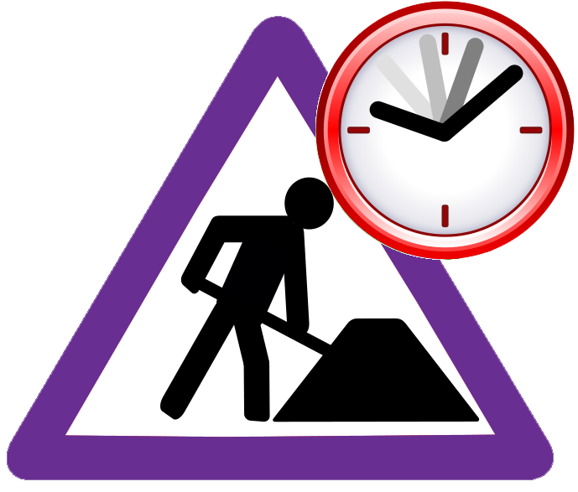


Process Simplification
request
{nb servers, model, app }
order
receive & rack & wire
Label (app)
deliver
“several”
weeks
1 w
2-3 w
repurpose
request
{nb servers, model }
order
Receive pre-racked
Pre-wired
deliver to
cache
request
{nb servers, model, app }
deliver
quarterly
45 min
1 day
2-3 w
repurpose

Slide 16
Open Source Integration
IaaS/PaaS API
IaaS/PaaS API
orchestration
Resource
Allocation
Distributed
State
orchestration
Resource
Allocation
Distributed
State
eBay
Cloud
Manager
AuthN/AuthZ
Application
Controller
Access Point
Controller
AuthN/AuthZ
Application
Controller
Access Point
Controller
Compute
Controller
Cluster
Controller
Pool
Controller
Compute
Controller
Cluster
Controller
Pool
Controller
Adopt and
Contribute
Infrastructure
Management
Services
Compute Mgt.
DNS Mgt.
LB Mgt.
Monitoring
Open Source
Solution
(openstack / Cloudstack)
Network Prov
Image/Pkg Repo
Software Dist.
Notes:
Today:
Missing features (Monitoring, DNS Mgt., LB Mgt, software deployment, PaaS level features…)
Not managing full lifecycle (focused on customer facing functions)
Impedance mismatch (ISP profile vs. eBay)
Infrastructure dependencies have scalability implications (mostly around network isolation)
➔ Gaps but catching up fast : opportunity to contribute
Future:
Adopt as much as possible and contribute
Increase open source footprint as maturity/feature set improves
Keep abstraction layer to provide eBay’s specific flavor and PDLC integration
➔ Adopt gradually but keep eBay’s abstraction

Slide 17
Join us at XDevCamp on Friday Oct 14th !
XdevCamp is a day of hands on instruction on X.Commerce, eBay, Paypal, Magento, and Red Laser technology.
http://xdevcampsf2011.eventbrite.com
Password: payxforward

